Slide 1
CYBER CAFE MANAGEMENT SYSTEM
Presented by:
JAYANTH KUMAR S
JEETHENDRA S R

Slide 2

INTRODUCTION
Computers have become a way of life for today’s high society. Many aspects of modern life that we have to accept as common place would not be possible if there were no computers.
Today computers are used extensively in many areas of business, science, education etc.
The major advantage of computer is its speed that makes it able to give some useful information very quickly. Another feature is its accuracy.

Slide 3
INTRODUCTION
This project is intended to be used in Cyber Cafe. All cyber cafes have some basic needs likeable to control the systems that are being rented to the customers and are charged on timely basis.
This project only have server part which runs on Admin system .
The Admin should have control over the usage of the client system and keep track of what the client is doing.
Computers can hold data and instruction in an electronic representation in internal memory and this data can be retrieved at any time.

Slide 4
PROBLEM STATEMENT
In existing system a lot of manual work has to be carried out. Large amount of paper work is involved which may cause high degree of error.
Registration of user names, keeping records of user are done manually, which is time-consuming process and there is possibility of making errors.
Administrator has to keep the track of time, which is tedious job. Once the user logs out, while preparing bill, he has referred to user details including name, login time and time allocated leading to possibility of causing errors in bill calculation.
This may be non-beneficial to administrator.

Slide 5
SOLUTION
The project entitled “Cyber Cafe Management System” is a software package, which can be used in cyber cafes for managing the clients and billing.
As this is automated cyber management system it makes it very easy for administrator to search details. Also the time allotment is done very efficiently and it provides fast service in term of the bill calculation and time management.
In this system admin can briefly view total number of user come in cyber cafe, add new users, update out-time, price and remarks, and view details of old users.

Slide 6
OBJECTIVE
The aim of our project is to replace the paper works & works done manually and to automate the existing trend in the cyber cafe. Be it user creation, their management or bill generation, everything is computerized.Since the admin job is done effortlessly.
To keep the track of time and user details including name, login time and time allocated efficiently.
To maintain and store files, record and documents in the internal memory and retrieve whenever required.
It makes it very easy for administrator to search details. Also time allotment is done very efficiently and it provides fast service in term of the bill calculation and time management.

Slide 7
FUNCTIONAL REQUIREMENTS
CREATING ACCOUNT
Description: This will make the account for the user which will be required to login whenever the user will open the software.
Response Status: It will check if the length of the username cross the specified limit, if so it will display error.
CREATE LOGIN INTERFACE
Description: Create a login interface which provide authentication to the valid owner to access the other informations.
Response Status: If the entered username or password is not in database it will reload the same page. It will open the next interface if the login credentials are correct.

Slide 8
FUNCTIONAL REQUIREMENTS
INPUT SYSTEM INFORMTION
Description: Ask owner to provide necessary system information for the system to operate further.
Response Status: Store the entered system information in the database.
UPDATE SYSTEM INFORMATION
Description: Show the user the system information and allow them to change it as required .
Response Status: Update the database with the new information.

Slide 9
FUNCTIONAL REQUIREMENTS
Show System information
Description: Show the user the system information.
Response Status: No response as there is no input just it will display the informations.
Enter Customer Information
Description: Ask the user the works it want to perform in café and what are his requirements.
Response Status: Record the requirements in the database .

Slide 10
FUNCTIONAL REQUIREMENTS
View Customer information
Description: Show the user the information about the customers who have visited till now.
Response Status: No response as there is no input.
CHECKOUT
Description: To provide the bill after the out-time of the customer.
Response Status: It provides with the bill calculation after checking out.

Slide 11
NON-FUNCTIONAL REQUIREMENTS
Performance Requirements: The primary performance requirement is processor speed and its better data parallelism hardware support. More the core better will be system performance. Intel coreI7 and Intel coreI5 are recommendable.
Safety Requirements: There are no safety requirements with this application, other than any normal hazards of password disclosure.
Security Requirements: The data of the users who have visisted the shop which is stored in the database should not be disclosed with anyone except the investigating autority with permission.This is important for the user privacy.The system should withstand any cyber attack if done.

Slide 12
NON-FUNCTIONAL REQUIREMENTS
Maintainability: The software should provide the ease to change the data on which it operate like it has been mentioned in functional requirements that there should be a function to change the system information like rates etc.
Adaptability: The system should inform the user if he tries to enter any value which is not practically possible because that might be any logical or typing error.

Slide 13
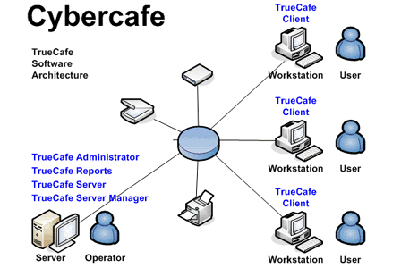
CYBER CAFE SYSTEM ARCHITECTURE

Slide 14
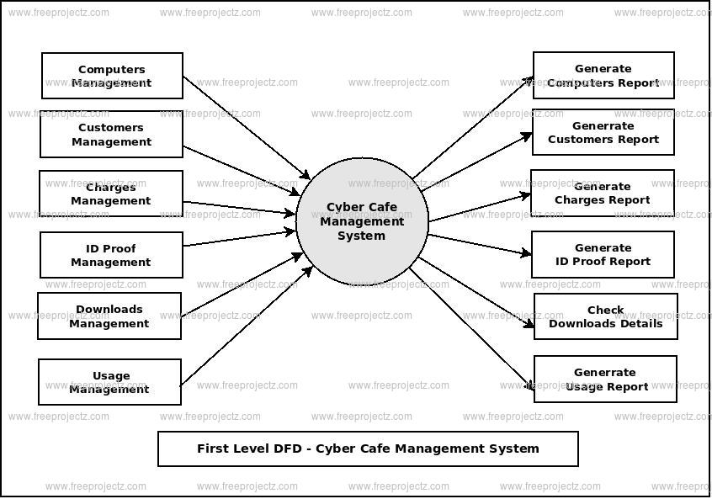
DATA FLOW DIAGRAM (DFD)
A dataflow diagram is a graphical view of data is processed in a system in terms of input and output.
The dataflow diagram(DFD) contains some symbol for drawing the data flow diagram.
The fig shows the neccessary elemental actions performed in the Cyber Cafe Management System.

Slide 15
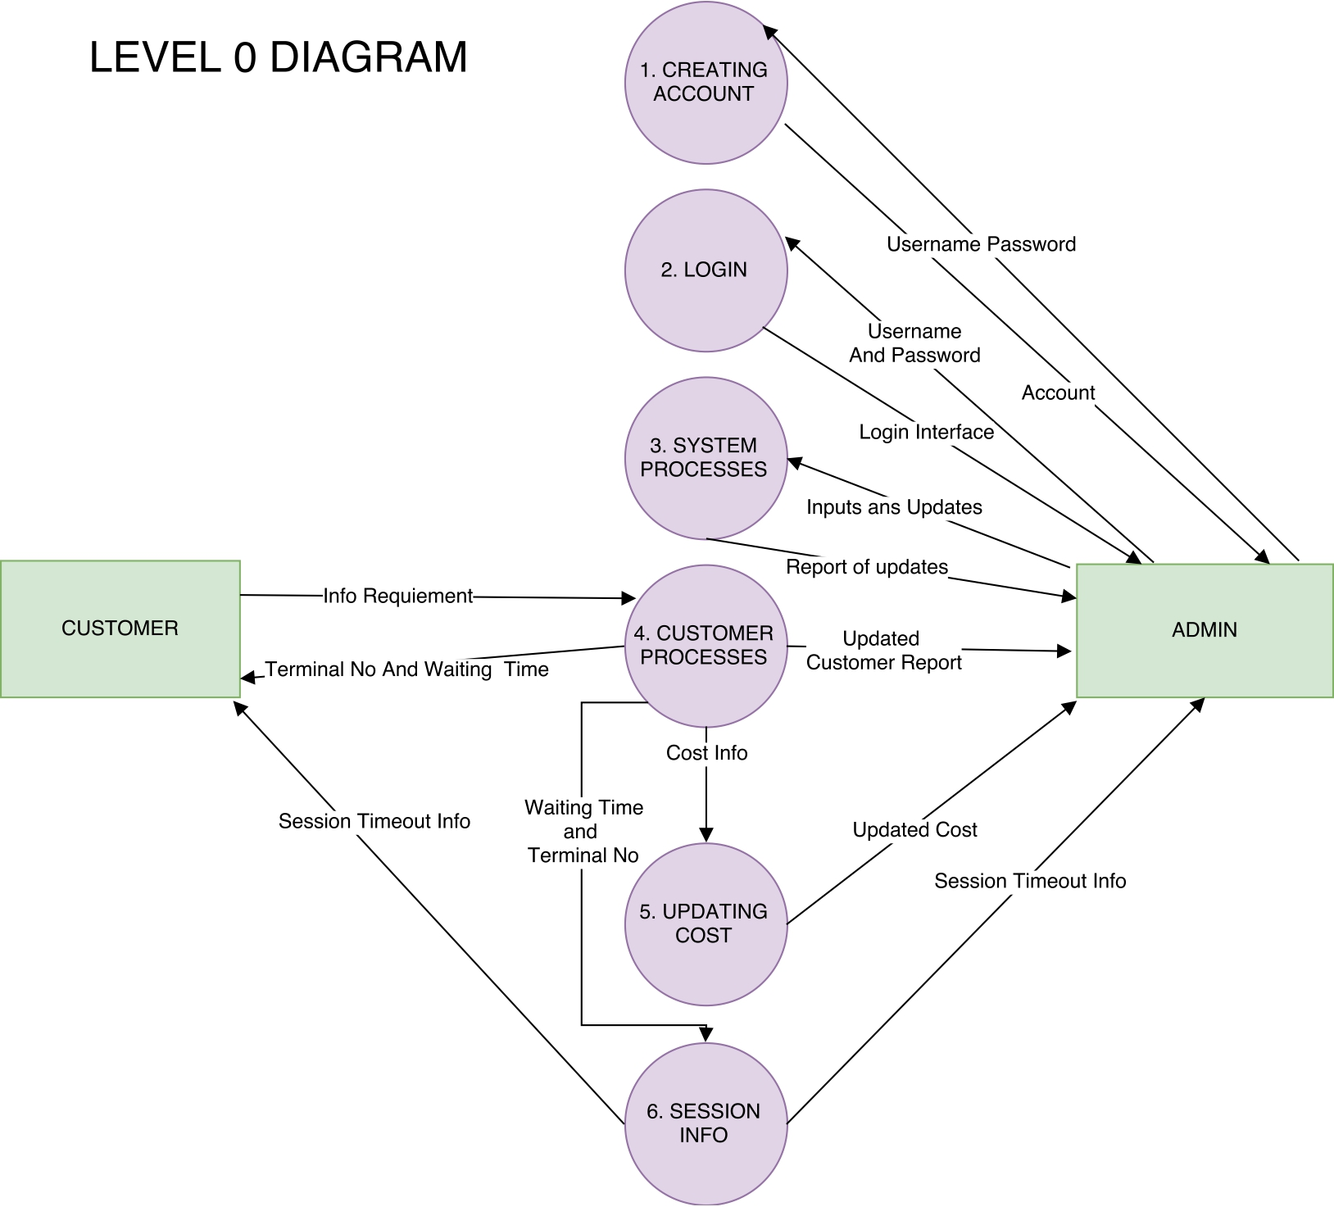
DATA FLOW DIAGRAM

Slide 16
MODULE DESCRIPTION
Cyber Cafe Management System has one module i.e admin.
Dashboard: In this section admin can briefly view total number of computers and total number of user come in cyber cafe.
Computer: In this section, admin can manage the computers(add/update).
Users: In this section, admin can add new users, update outime, price and remarks, and view details of old users.
Search: In this section admin can search users on the basis of entry id.
Profile: In this section admin can update his/her profile.
Change Password: In this section admin can change his/her passwords.
Logout: Through this button admin can logout.

Slide 17
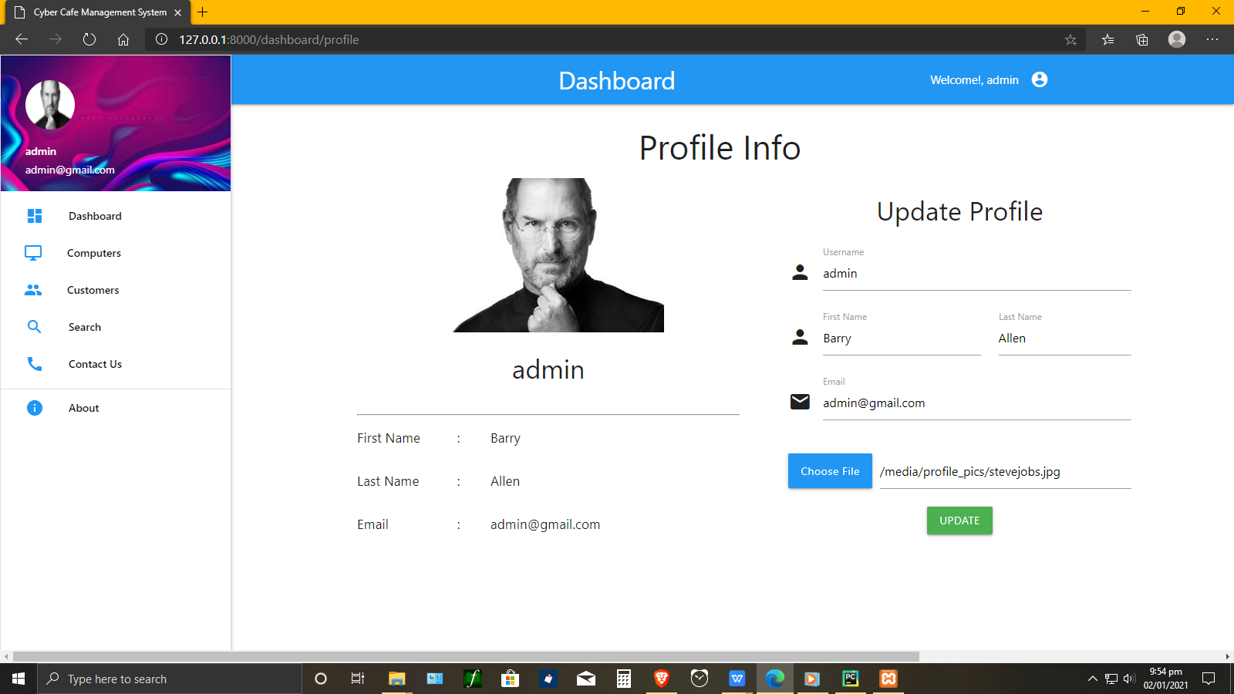

Slide 18
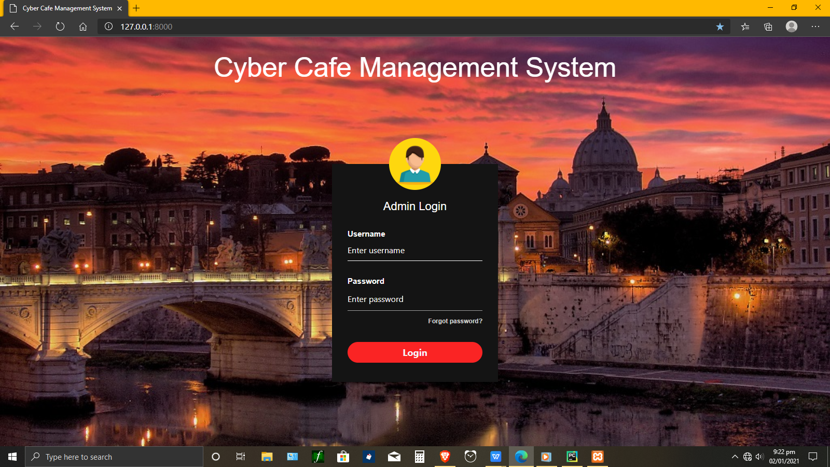
LOGIN PAGE

Slide 19
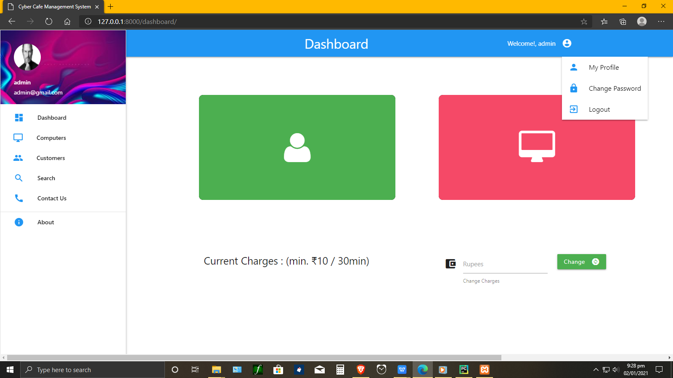
DASHBOARD

Slide 20
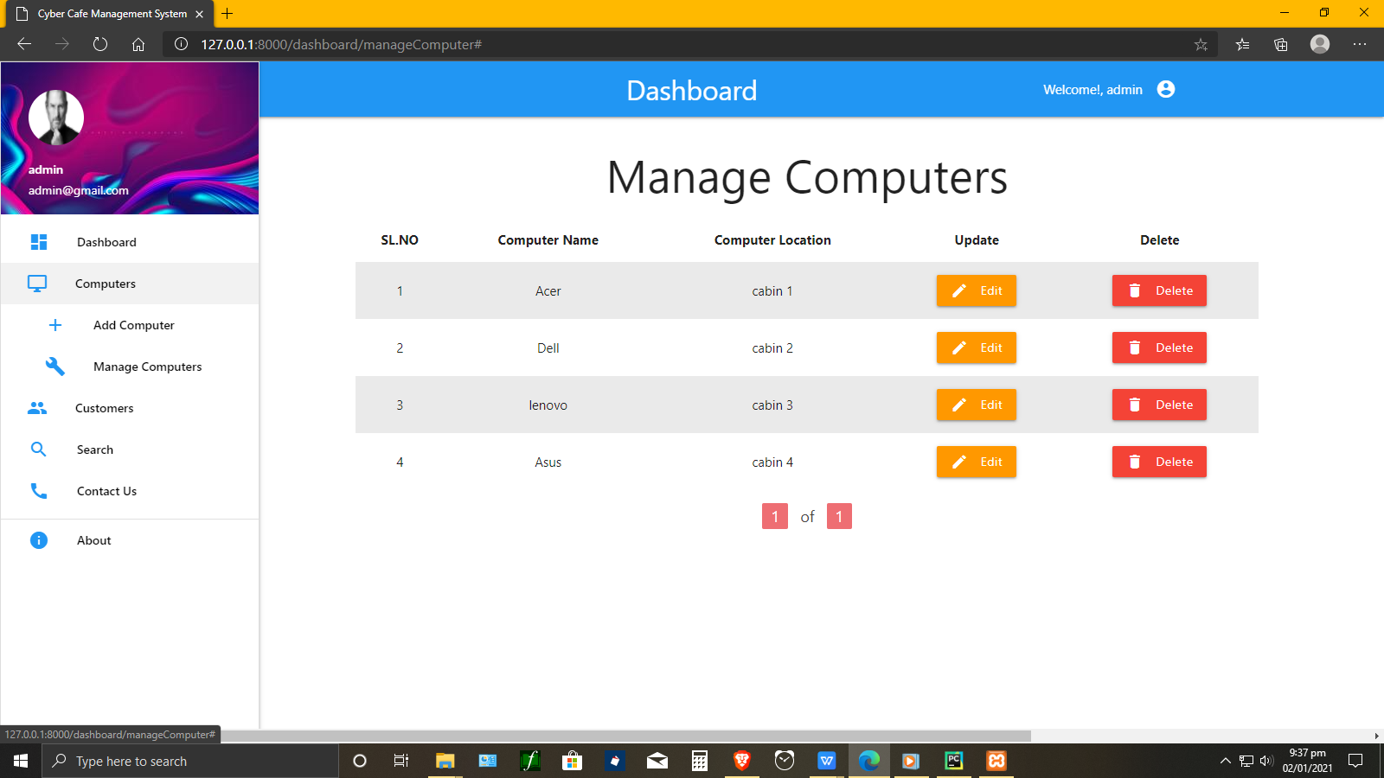
SYSTEM INFORMATON

Slide 21
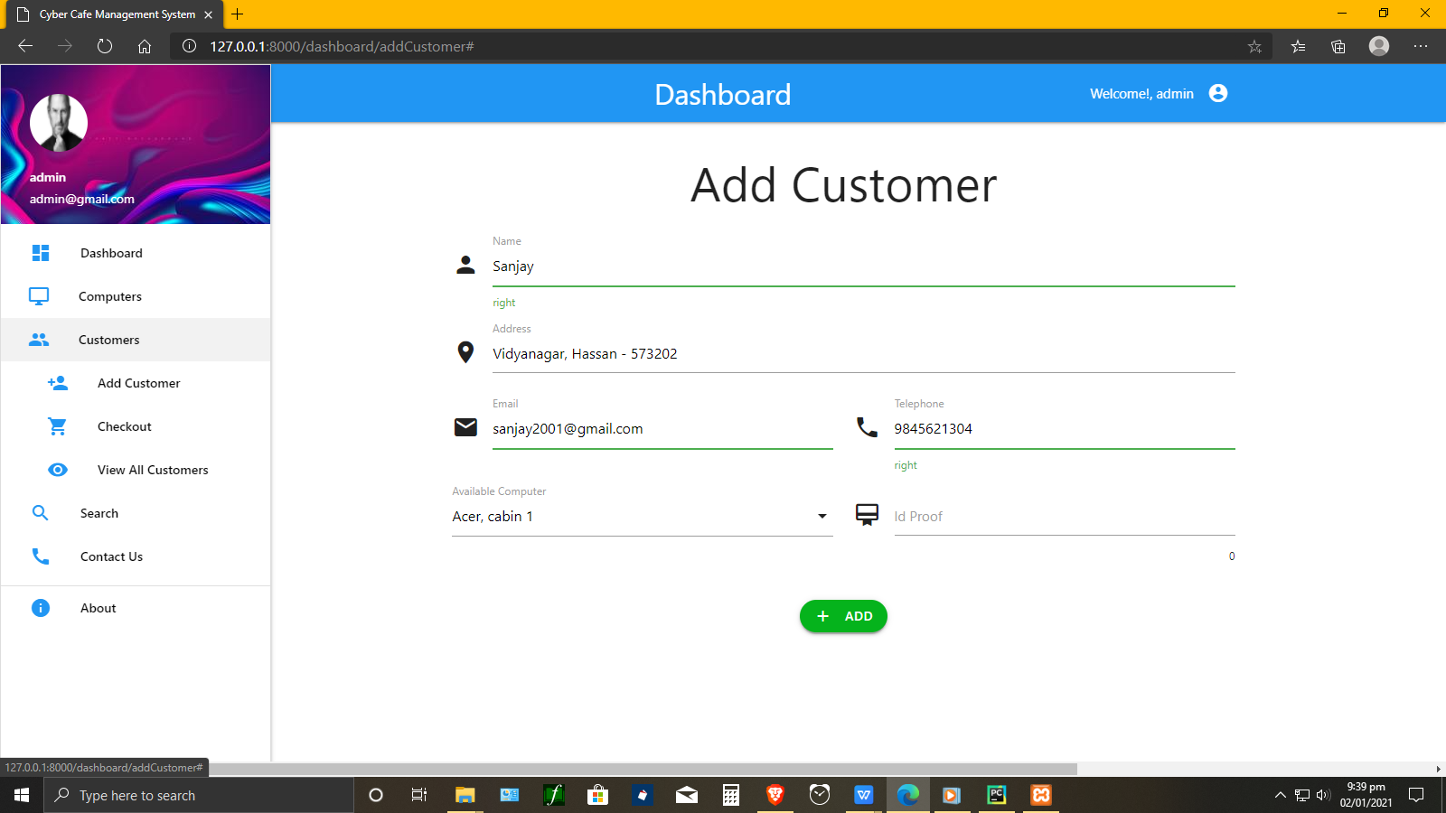
CUSTOMER INFORMATION

Slide 22
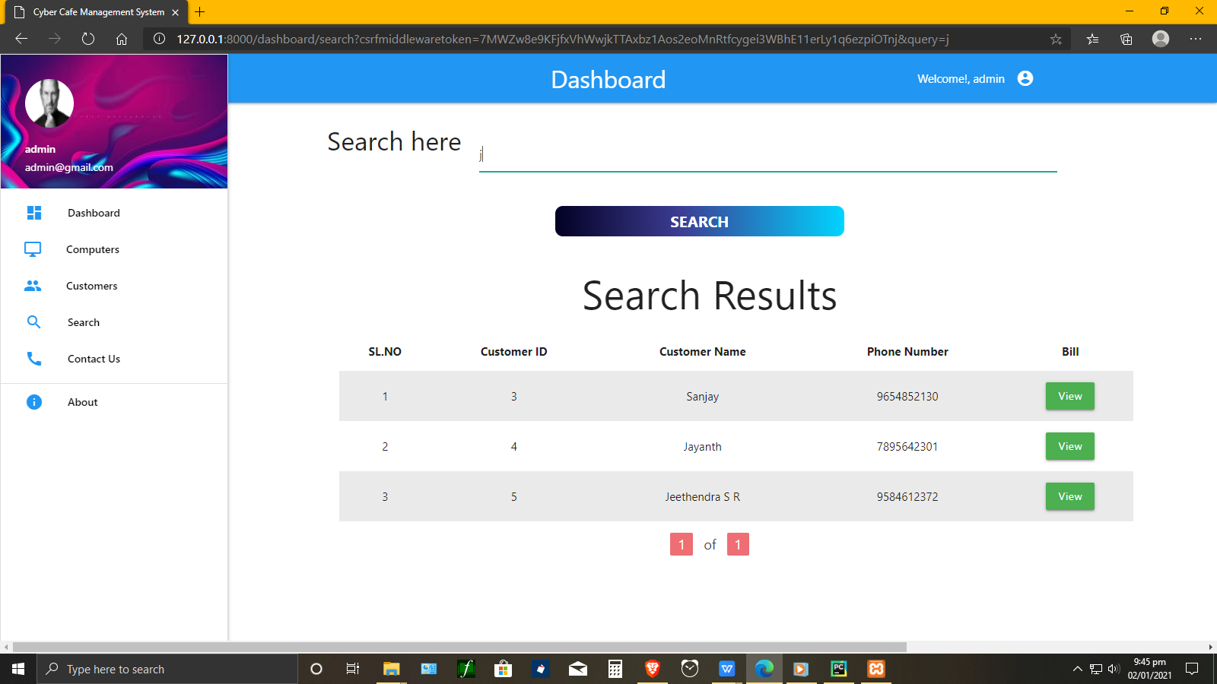
SEARCH CUSTOMERS

Slide 23
PROFILE INFO

Slide 24
CONCLUSION
Cyber Cafe management system provides the ease to the owner to distribute the customer to different terminals in best possible way and to know when the session is complete.
Its major advantage is that it records the type of terminals accessed by the customers and full details of the customers are recorded in the database so that if any enquiry is needed by anyone later it can be systematically done.
It works the admin front so user cannot manipulate or access any part of the information in the system.
the time allotment is done very efficiently and it provides fast service in term of the bill calculation and time management.

Slide 25
REFERENCES
https://docs.djangoproject.com/en/3.1/intro/
https://youtube.com/playlist?list=PLebdnM09G8Kj8vgXsFjPuLaNoN7H3nHNM
https://en.wikipedia.org/wiki/Internet_caf%C3%A9
https://www.academia.edu/38153262/Cyber_Cafe_Management_System_Project_Report
https://github.com/topics/dbms-project
https://w3points.com/django-tutorial/
https://stackoverflow.com/questions/20575809/django-tutorial

